Slide 1
Territorial decentralisation and climate governance
El dret de la UE davant l’emergència climatica – Universitat de Barcelona, Facultat de dret

Slide 2
Agenda
Climate governance in the European Union and decentralisation
Decentralising climate governance: Italy and Belgium
Concluding and comparative remarks

Slide 3
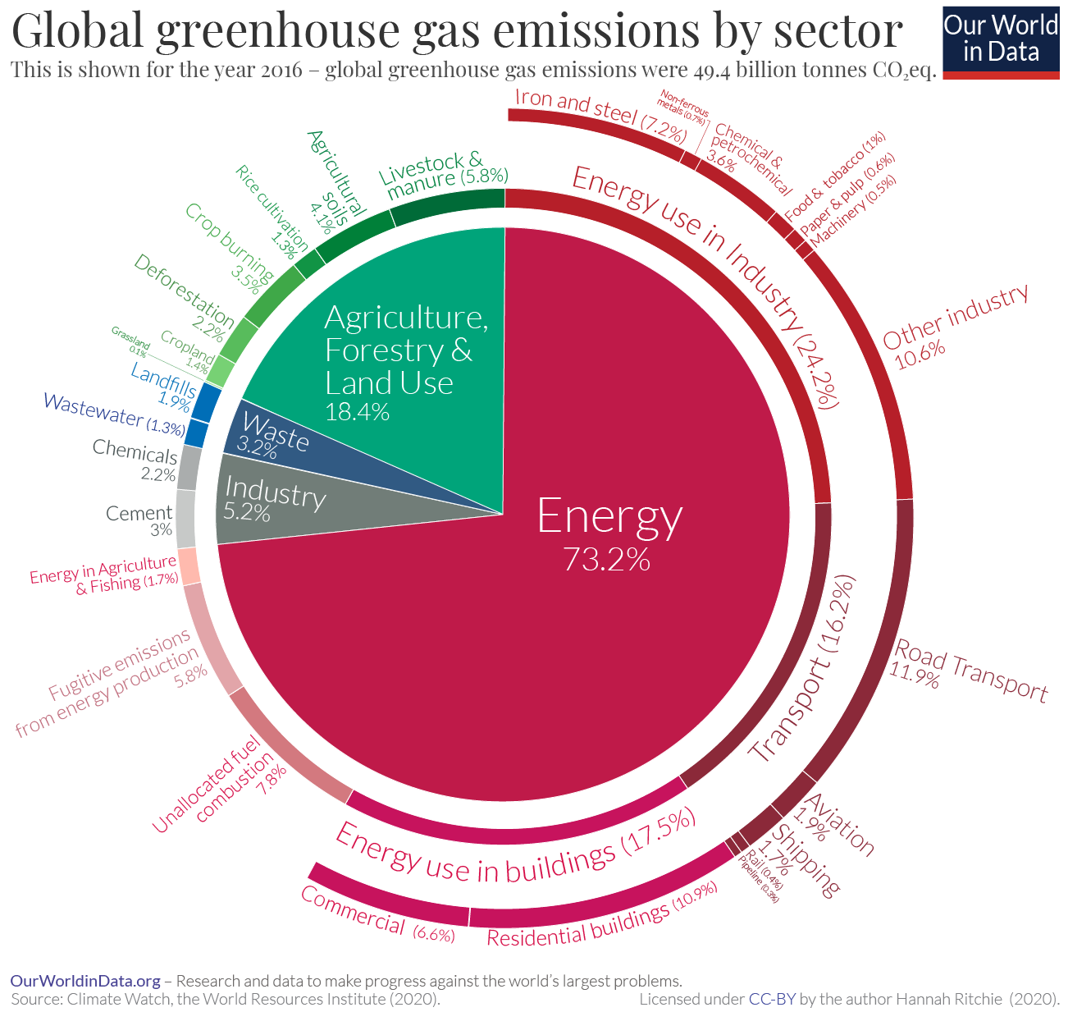
Global warming in its current state is an issue that is unqualifiable, not in theory but in practice, for no framing is able to embrace it in its entirety. As the roots of the word indicate, an issue always finds an exit enabling it to overflow. It is protean, constantly changing as it spreads, irrespective of the frame into which we try to fit and enclose it. (M. Callon)
Notes:
As argued by the literature, governing climate change poses at least two institutional challenges to compound states such as Italy. It requires a higher level of vertical coordination among different levels of government because climate governance intersects with a number of subject matters that are either a state-exclusive competence or shared between the national and subnational levels or where subnational governments are entitled to exercise residual legislative and executive competences
Second, as the governance of climate change is not (and cannot be) contained within any single sectoral policy at either the national or subnational levels, on the contrary, it is transversal to a number of policy fields such as environmental protection, energy policy, water management, spatial planning, agriculture, etc., it requires further horizontal integration efforts, as governments need to enact legislative and administrative measures in a range of different sectoral policy areas. Coordination at different governmental levels and across sectors is, therefore, necessary to ensure both the coherence and effectiveness of mitigation and adaptation initiative

Slide 4
This is the law of the laws, because it will discipline us in the years to come (F. Timmermans)
Bindingness
Mid to long-term GHG emission reduction targets (Art. 4)
Carbon budget and trajectories (Art. 3)
Stewardship
EU Scientific Advisory Board on CC (Art. 3)
Monitoring and Enforcement
Assessment of Union progress (Art. 6)
Solidarity (Art. 2)
Sectoral roadmaps → (Art. 10)
Assessment of national measures (Art. 7)

Slide 5
Bindingness
Multi-level system → NECPs
Dialogue platforms → Social Climate Fund, JTF, EU Climate Pact, etc.
Coordinated action → REPower EU, RRF
Monitoring and Enforcement
EC recommendations + infringement procedures → Governance Regulation
Compliance → Effort Sharing Regulation
Stewardship
Sectoral targets → Renewable energy (40%, RED II), Energy efficiency (36%, EED), GHG from non-ETS sectors (ESR), Biofuels, LULUCF, etc.

Slide 6
Symbolic vs. effective legislation (Torney, 2022) → Ownership gap?
Climate governance
Policy and institutional integration
Mitigation + adaptation + sectoral approaches
Accountability
Obligations lock-in and time consistency
Public participation, access to information and justiciability
Policy tracking (no-regression principle)
Predictability
Investment protection and inflow
Credibility
Ambition and increased institutional/political quality

Slide 7
Decentralising or not decentralising?
Locally tailored responses
”Compensatory role” of constituent units
Policy innovation and interjurisdictional learning, ”political learning”
Potential veto points
Patchwork policy-making
Wait-and-see approach / freeriding

Slide 8
Agenda
Climate governance in the European Union and decentralisation
Decentralising climate governance: Italy and Belgium
Concluding and comparative remarks

Slide 9
1. Belgium

Slide 10
Regions
(+ local gov.)
Federal Government
Communities
Federal government
Regional governments
Local/sub-local governments
Executive federalism → “Partocracy”
Dual federation → Fragmented competences → ‘what we do ourselves, we do better’ → Accountability
No pre-emption of Regional Governments → Volutary Cooperation is the only way → Unanimity
How a Federal State works
How Belgium works

Slide 11
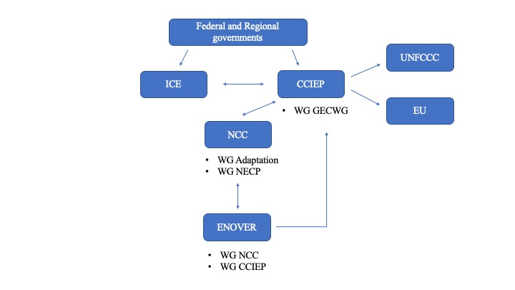
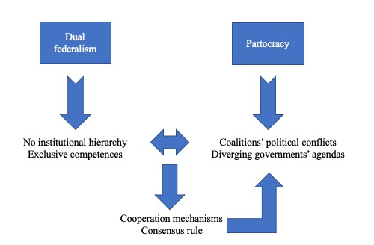
No advisory body on CC
Advisory councils on development (Conseil Fédéral du Développement Durable)
Inter-parliamentary climate dialogue; ENOVER-CONCERE
Co-operation agreements (too burdensome, similar to intl. treaties!); inter-ministerial conferences → unanimity

Slide 12
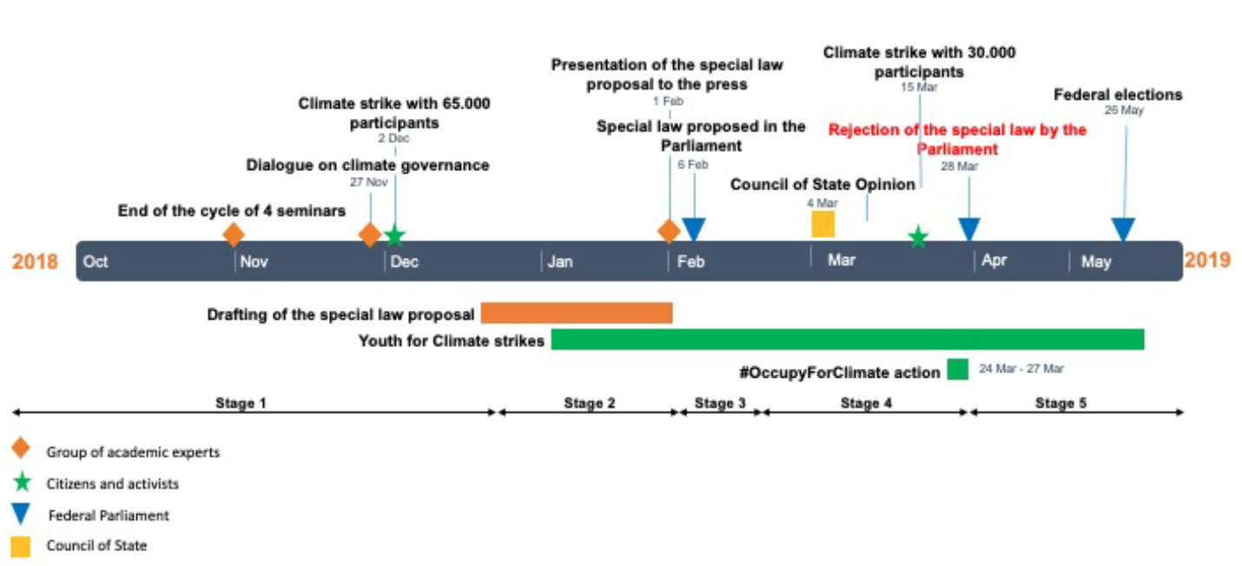
2 examples: a) The failed adoption of the Belgian climate law
Introduction of Art. 7-bis in the Constitution → Rejected
“the state, communities and regions have to respect binding climate objectives defined in a special majority law or a simple majority law”
(Source: A. Orsini et al, 2021)

Slide 13
Two examples: b) The first Belgian NECP
The division of competence between the different federated entities
in Belgium presents a challenge to arrive at an integrated NECP.
When proceeding to the finalisation of the NECP, additional coordination efforts will be needed to present an integrated national vision on how
to achieve the objectives of the Energy Union towards 2030, while ensuring overall consistency and coherence
with the federal and regional plans.
(EC, 2020)

Slide 14
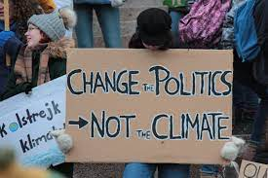
Klimaatzaak: Background and Legal strategy
Case filed in 2014 (Brussels Court of 1st instance); Decided in 2021
> 68.000 plaintiffs (WR!) + 82 trees
Respondents: Federal State + 3 Regions
2019: Federal Climate Law Bill rejected
Legal strategy:
Art. 1382-1383 BCC + Art. 2+8 ECHR (+ Art. 6+24 UN Convention on the Rights of the Child)
Duty of care of Federal State + Regions → GHG emission targets for 2025, 2030 and 2050
Remedies requested: Injunction (order: -42%/48% by 2025; 55%/65% by 2030; net-zero by 2050).

Slide 15
The decision
French-Speaking Court of 1st Instance Brussels, 4th Chamber, 17.6.2021
Duty of care established in light of:
The mixed results in terms of figures.
The lack of good climate governance.
Repeated warnings from the European Union.
Declaratory judgment – you have behaved badly, but can still make up for your it … → No injunctive relief; No binding targets → Separation of powers
In short, cooperation between the federal authority and the federated entities is, by the admission of various state bodies, deficient to date, which leads some authors to consider the climate governance framework to be fundamentally inadequate”

Slide 16
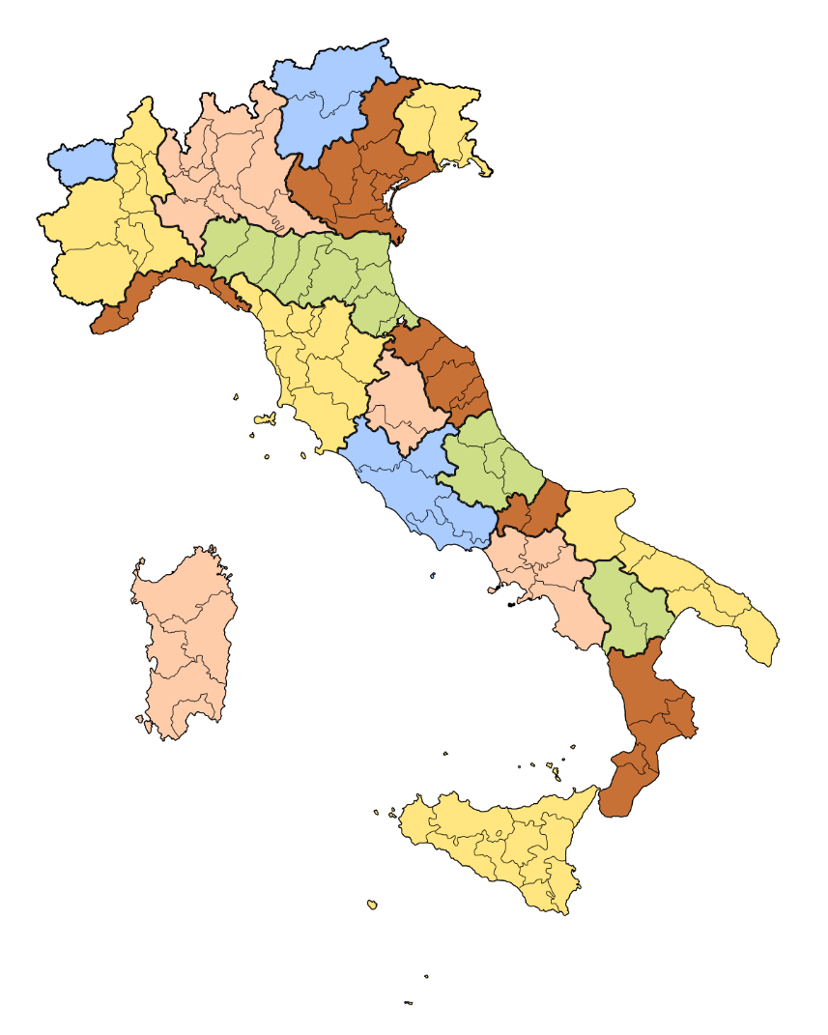
2. Italy

Slide 17
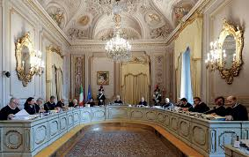
Article 117 Italian Constitution → Allocation of competences
Shared competences (health protection, disaster relief, land-use planning, national production, transport and distribution of energy)
Climate change as a “subsumed” environmental issue (Alberton) → “transversal character” of environmental legislation implied the prevalence of state legislation over regional concurrent legislation in other fields (e.g., urban planning, etc.) whenever they intersected
“subsidiarity call” doctrine (Const. Court, Judgment no. 303/2003) → litigation
Weak inter-institutional cooperation mechanisms (Conferenza Stato-Regioni; Conferenza Unificata)
Autonomous Regions vs. Ordinary Regions
Vertical coordination (Article 120 Constitution)
Horizontal cooperation (Integrated Regional Plans; Ad hoc agencies; Inter-Municipal cooperation)

Slide 18
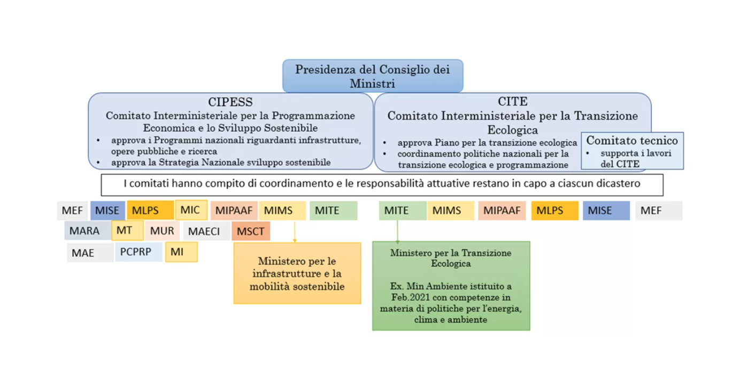
Source: ECCO Climate

Slide 19
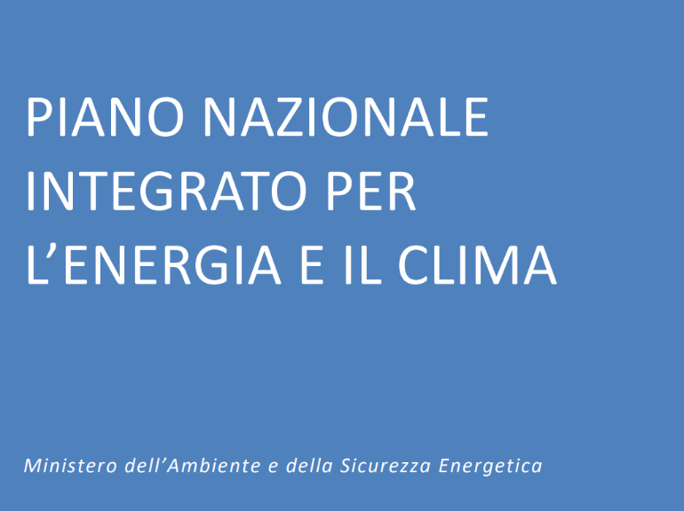

Slide 20
Agenda
Climate governance in the European Union and decentralisation
Decentralising climate governance: Italy and Belgium
Concluding and comparative remarks

Slide 21
Comparative remarks
Consensus democracy and consociational federation (pacification) → Broad coalition, proportionality, segmental autonomy, veto for minorities → compromise to avoid conflicts → race to the bottom?
No hierarchy → Low political will is fostered by heavy de-centralised and no-hierarchy structure (double-edged sword)
Constitutionally dual yet de facto co-operative federalism → Complex inter-governmental decision-making process and heavy political lift
Centralisation process + differentiated federalism
Hierarchy established, with asymmetries (e.g., Ordinary vs. Autonomous Regions; Execution of shared competences)
Constitutionally dual (?) with loose cooperative mechanisms → Litigation!
No climate laws and lack of overarching policy coordination
EUropeanisation of climate governance
Informal cooperation can override formal limitations → COVID-19 crisis response

Slide 22
Thank you for your attention! Gràcies per l’atenció! m.fermeglia@uva.nl

