Slide 1
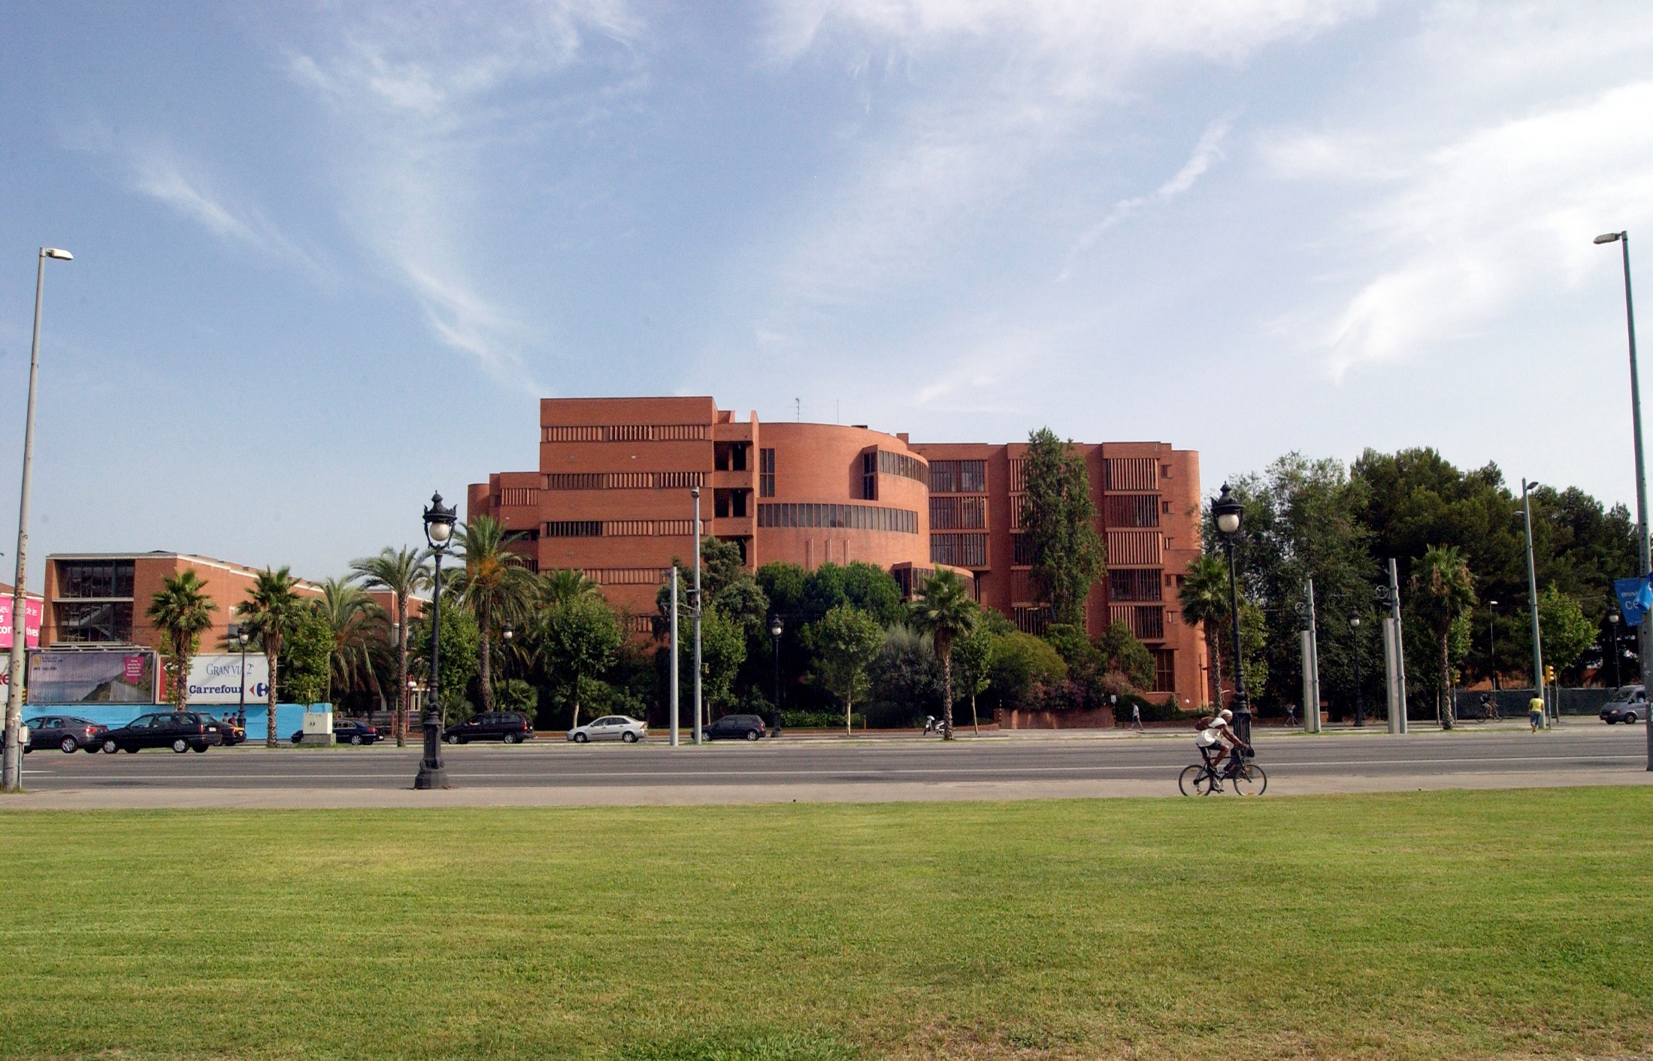
Benvinguts a la Facultat de Biologia UB
September 9th 2022
Notes:
Welcome, Bienvenus, Wilkomen, bienvenidos, benvinguts a la facultat
Aquí estudiareu diferents aspectes del gran arbre de la biologia,
Pero també es important que conegueu a fons la nostra terra, com som els barcelonins, els catalans,
Com es la nostra cultura, com son les nostres tradicions.
Jo us en faré un tastet aprofitant els mesos del calendari academic

Slide 2
Welcome Session for the Incoming Students
Schedule
10:00 Serveis Lingüístics (Catalan Language Courses) (Elisenda Vilageliu)
10:30 Estudios Hispánicos (Spanish Language Courses) (Dàmaris Álvarez)
10:45 Presentation of the Incoming students’ group
11:00 Presentation of the UB and Faculty of Biology , Courses, registration .... and more information (ORI-BIO)
12:00 Erasmus Student Network (ESN) presentation (Alex Castillo)
12:30 Visit of the Faculty and Library
13:00 Pica-pica

Slide 3
Welcome Session for Incoming Students Facultat de Biologia UB
September 9th 2022
by ORI BIOLOGIA Team
(Laura Gabarrón, Cristina Madrid,
Marta Camps )

Slide 4
ORI - BIOLOGIA International Relations Office
Laura Gabarrón
Email: ori-bio@ub.edu
Laura is working in our office :
Tuesday 10h-14h
Wednesday 10h-14h
Friday 10h-12h
Please send to ori-bio@ub.edu an email to book an appointment
Please send an email to Marta Camps martacamps@ub.edu
if you want to talk to her
Notes:
4
Facebook???
Horari
Dies de festa ??

Slide 5
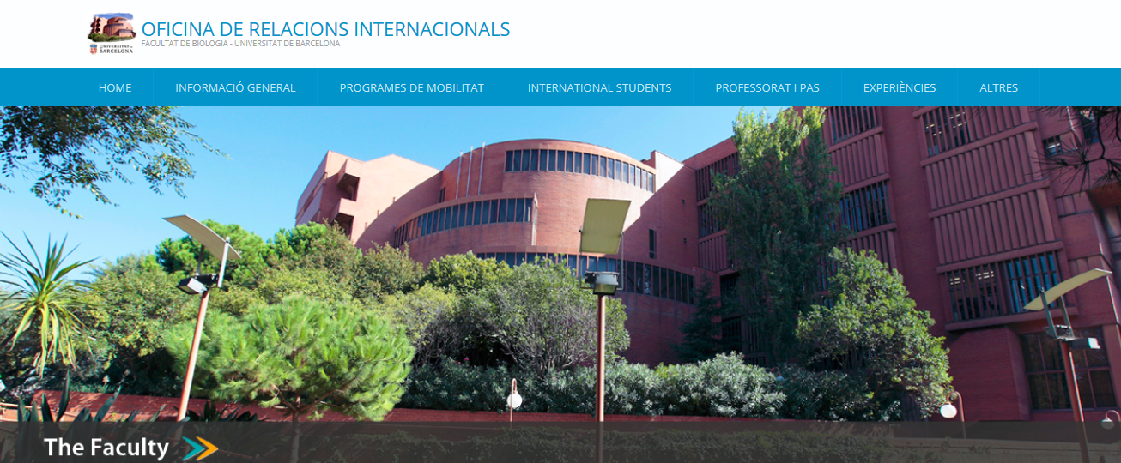
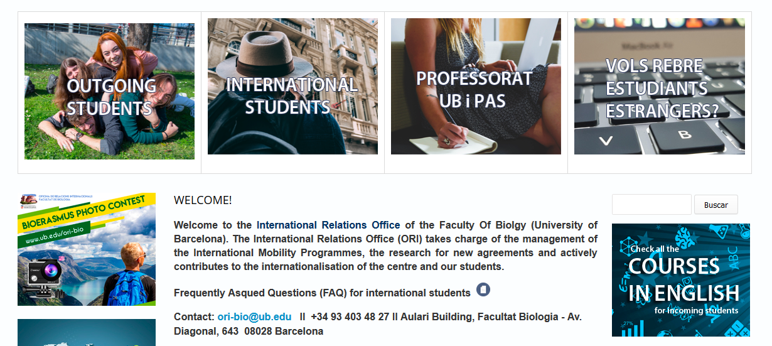
http://www.ub.edu/ori-bio/

Slide 6
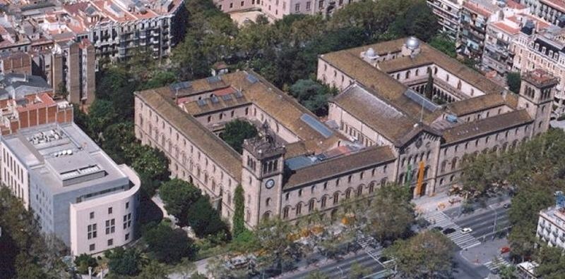
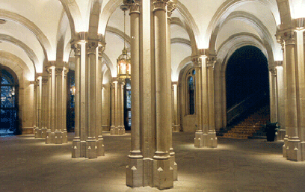
The University of Barcelona (since 1450)
Public and strongly research-oriented
Balances tradition and modernity
Comprehensive university: almost any discipline except engineering fields and architecture
The best University in Spain according to the international rankings

Slide 7
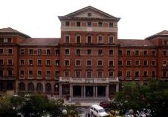
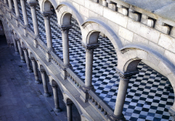
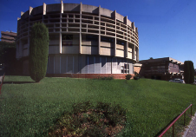
Faculties, institutes and centres
16 faculties
60 departments
9 affiliated centres
6 city campuses
16 libraries
27 research institutes:
14 only UB
10 with UB participation
3 with other universities
12 observatories

Slide 8
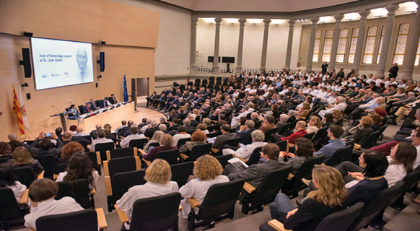
The UB in numbers
EDUCATION
73,926 students
11,231 international students
41,540 bachelor’s degree students
4,776 university master’s degree students
4,816 doctoral students (1,464 international)
754 doctoral theses read
73 bachelor’s degrees
15 dual study pathways
170 university master’s degrees
46 doctoral programmes
22 masters taught in English
> 500 online/on-site courses
750 postgraduate courses
STAFF
5,696 teaching and research
(250 international)
2,387 administrative and service employees

Slide 9
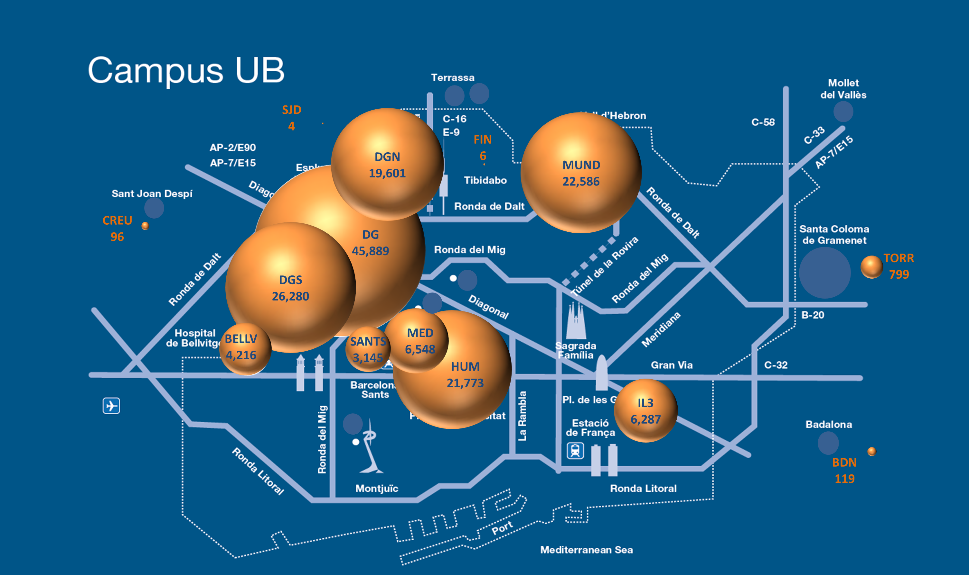
The UB in Barcelona
The university community by campus and building
HUM
Humanities Campus
BELLV
Bellvitge Health Sciences Campus
SANTS
UB Sants Building
MED
Medicine Campus-Clínic August Pi i Sunyer
MUND
Mundet Campus-University of Barcelona
IL3
IL3-UB
DG
Diagonal Knowledge Gateway Campus
TORR
Torribera Food and Nutrition Campus
FIN
Pedro Pons Estate
DGN
Diagonal North
BDN
El Carme Cultural Centre
SJD
Sant Joan de Déu Building
DGS
Diagonal South
CREU
La Creu-Sant Joan Despí Tower

Slide 10
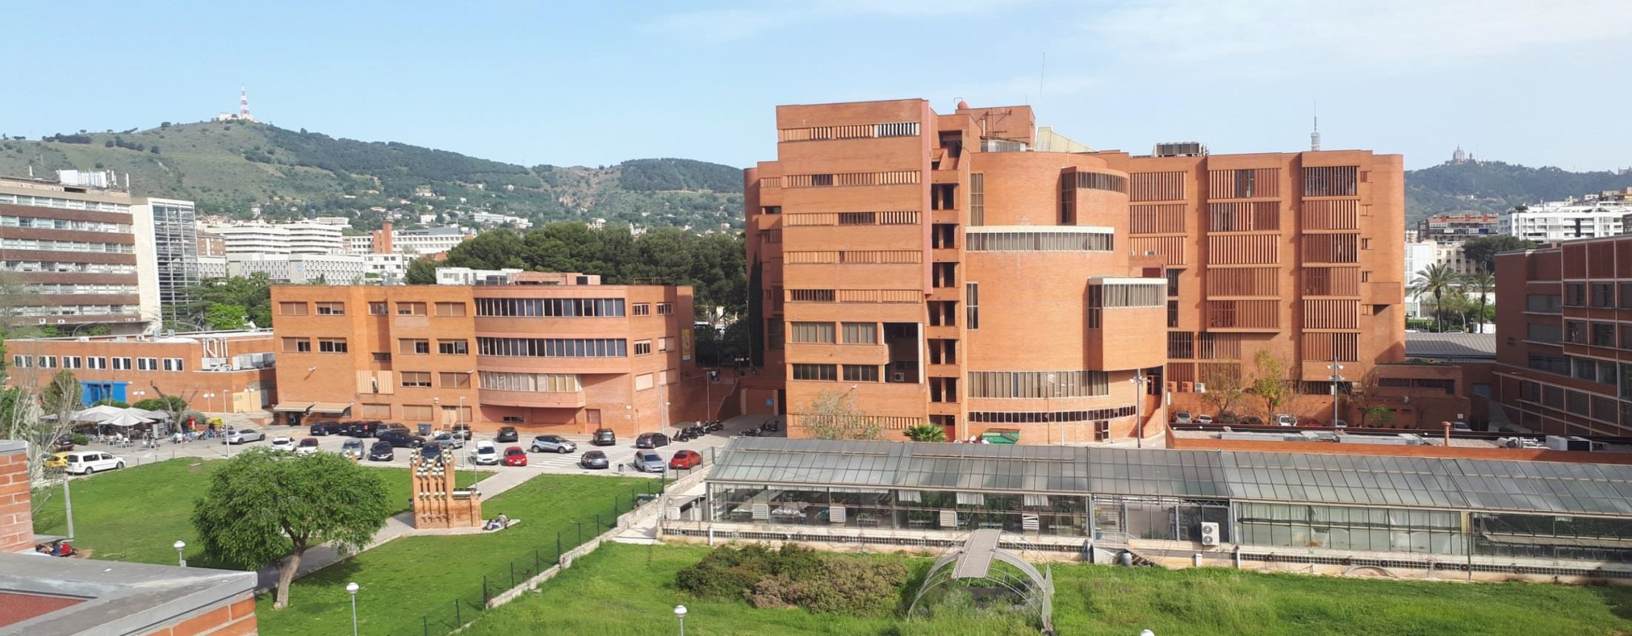
The Faculty of Biology
at the University of Barcelona

Slide 11
Our Faculty in Numbers
Founded in 1974 (pioneer in Spain)
Position of the University of Barcelona (UB) in Biosciences according to the QS University Ranking
Spain 1
Europe 23
World 70
About 370 professors and 2,870 students including undergraduates, master students and PhD students
Located in an active and stimulating campus that includes the Faculties of Physics, Chemistry, Pharmacy, Earth Sciences as well as the Scientific Park of Barcelona that hosts the Institute for Bioengineering of Catalonia (IBEC), Institute for Research in Biomedicine (IRB) and the Institute of Molecular Biology of Barcelona (IBMB-CSIC), among others

Slide 12
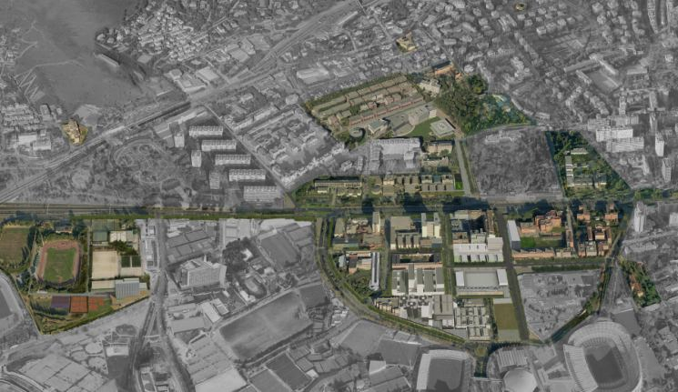
Our Faculty location
CSIC
Economics and
Business
Law
Physics
Biology
Sports UB
Chemistry
Pharmacy
and Food
Sciences
Earth Sciences
PCB
IBEC
IRB

Slide 13
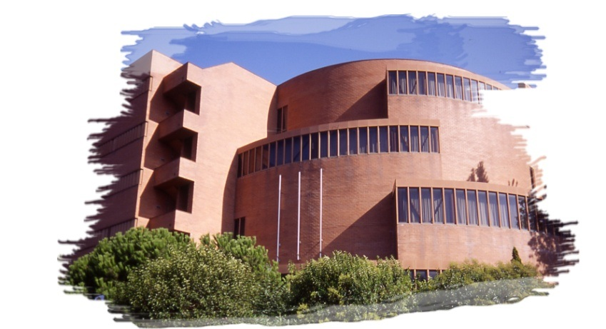
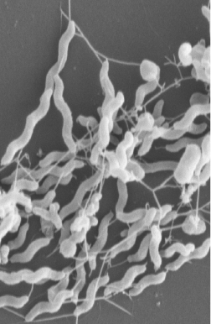
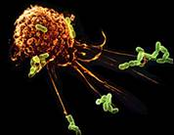
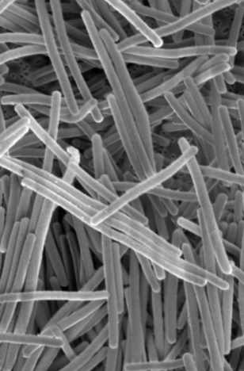
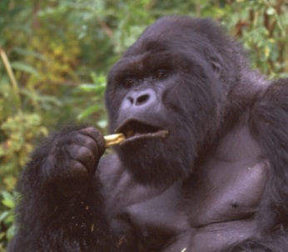
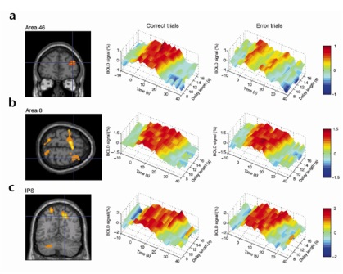
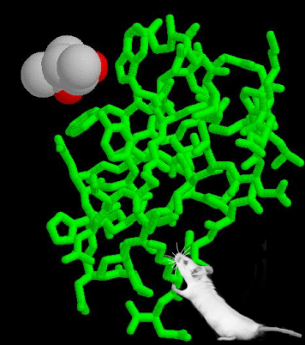
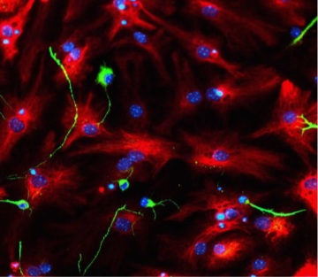
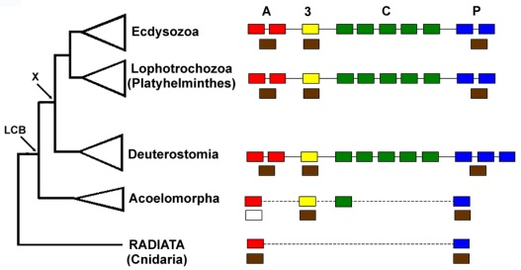
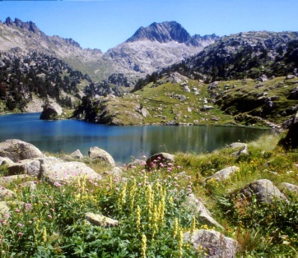
Our Departments
Dept. Biochemistry and Molecular Medicine
Dept. Cell Biology, Physiology and Immunology
Dept. Evolutionary Biology, Ecology and Environmental Sciences
Dept. Genetics, Microbiology and Statistics

Slide 14
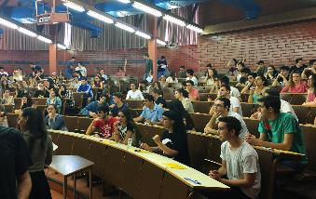
Bachelor Degrees
- Biology 707 students (ranked as the nº1 degree in Biology among 17 Spanish universities)
- Biochemistry: 232 students
- Biotechnology: 330 students
- Environmental sciences: 306 students
(ranked as nº2 degree in Environmental sciences among 17 Spanish universities)
- Biomedical sciences: 468 students
Also participate in the Degrees of Bioinformatics and Marine Sciences

Slide 15
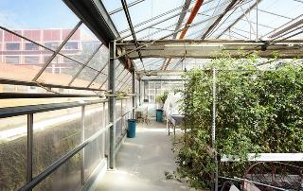
Master Programs
Master programs:
Advanced Immunology (partly in English)
Advanced Microbiology
Aquaculture
Biodiversity
Biological Anthropology
Ecology, Environmental Management and Restoration
Environmental Agrobiology
Genetics and Genomics (fully in English)
Integrative Physiology
Neurosciences (partly in English)
Oceanography and Marine Environment Management
Biomedicine (partly in English)
Molecular Biotechnology (partly in English)

Slide 16
3 Buildings at Faculty of Biology
Edifici Margalef (center, roundish)
Aulari (right, square)
Edifici Prevosti o Annex (left, L-shaped)
Edifici Margalef
Aulari
Edifici Prevosti
Hivernacle
Notes:
Pero també poden realitzar-les
- estudiants de primer cicle
- que hagin fet un minim de un curs sencer (60 crèdits)
- idealment, que hagin fet TOTES les OBLIGATORIES
- estudiantsllicenciats que cursin
- el Master Experimental, o
- el Doctorat.

Slide 17
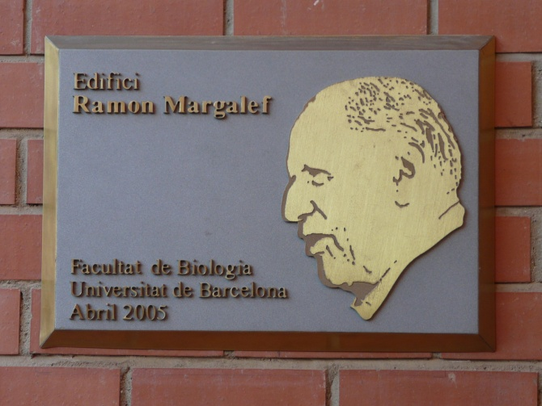
http://www.ub.edu/biologia/queoferim/index/espais.htm
Hivernacle
(Greenhouse)
Edifici Prevosti
Aulari

Slide 18
Aulari
Erasmus Office * (1st Floor)
Aula de Graus (1st Floor)
Now Aules A1-A17
Computer rooms iA1 and iA2
Laboratories for practices (Ground Floor). Now lab A1-A9
Cafeteria (Ground Floor)
Dept. Genetics, Microbiology and Statistics (Second Floor)
Notes:
Especificar les aulas

Slide 19
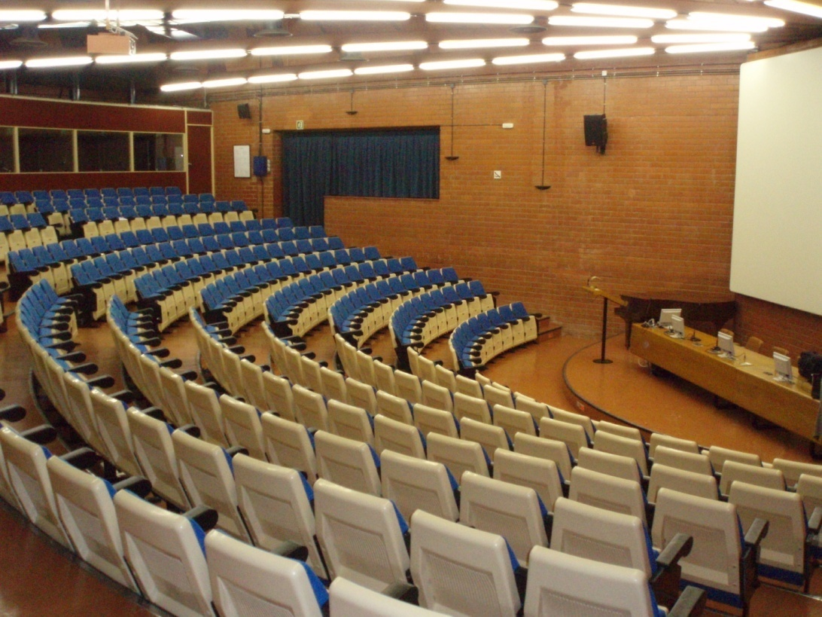
Edifici Margalef
Computer Rooms (GF)*
Bookshop and Photocopy Service (GF).
Aula Magna (GF) & other aulas M1-M6
Dept. Evolutionary Biology, Ecology and Environmental Sciences
Dept. Cell Biology, Physiology and Immunology

Slide 20
Edifici Prevosti
Laboratories for practices: laboratories lab P1-P8
Library (-1 level).
Aulas P1 and P2
Computer rooms iP1-iP3
Dept. Biochemistry and Molecular Medicine
Dept. Cell Biology, Physiology and Immunology
Dept. Genetics, Microbiology and Statistics
Notes:
Quins labs I quinesalues

Slide 21
Courses offered at Facultat de Biologia Undergraduate programmes http://www.ub.edu/biologia/
BSc Biology
BSc Biochemistry
BSc Environmental Sciences
BSc Biotechnology
BSc Biomedical Sciences
https://www.ub.edu/portal/web/biologia/graus/-/ensenyament/detallEnsenyament/6006880/24
https://www.ub.edu/portal/web/biologia/graus/-/ensenyament/detallEnsenyament/6006891/24
https://www.ub.edu/portal/web/biologia/graus/-/ensenyament/detallEnsenyament/6006941/24
https://www.ub.edu/portal/web/biologia/graus/-/ensenyament/detallEnsenyament/6006953/24
https://www.ub.edu/portal/web/biologia/graus/-/ensenyament/detallEnsenyament/6007686/24
Notes:
Arreglar-ho

Slide 22
Courses offered at Facultat de Biologia
Postgraduate programmes
https://www.ub.edu/portal/web/biologia/masters-oficials
Màster d’Agrobiologia Ambiental
Màster en Antropologia Biològica
Màster en Aqüicultura
Màster en Biodiversitat
Màster en Ciències del Mar: Oceanografia i Gestió del Medi Marí
Màster en Ecologia, Gestió i Restauració del Medi Natural
Màster en Fisiologia Integrativa
Màster en Genètica i Genòmica
Màster en Immunologia Avançada
Màser en Microbiologia Avançada
Màster en Neurociències
Màster en Biomedicina
Màster en Biotecnoogia Molecular
At other Faculties at UB:

Slide 23
Subjects from Faculties other than Biology
Cannot exceed 49% of the total.
We need to request permission to the person in charge of international exchanges of the faculty that offers the course you are interested in. Should be a written permission filling this document

Slide 24
Laboratory Training (Project)
If you are an Erasmus Excchange student performing an internship in a laboratory, you should register it.
Two options:
Code 1st semester | Code 2nd semester | Name | ECTS
399430 | 399431 | Pràctiques de laboratoris per a Estudiants Estrangers. | 15
399432 | 399433 | Pràctiques de laboratoris per a Estudiants Estrangers. | 30

Slide 25
Laboratory Training (Project) … (cont.)
Faculty of Biology
Faculty of Pharmacy and Food Sciences
Faculty of Medicine and Health Sciences
Other Research Institutions (If you find a research group in an institution other than the faculty of biology please, contact us because it might be necessary to make some traineeship agreement with the institution)
Institut de Biomedicina UB
Institut de Neurociències UB
Institute de Nanociències i Nanotecnologia UB
Institute for Bioengineering of Catalonia
Institut de Recerca Biomèdica de Barcelona
IDIBAPS (Biomedicine)
IDIBELL (Biomedicine
CRAG (Agrobiology)
IBE (Evolutive Biology)
CREAF (Ecology)
CSIC (Spanish Research Council)
o Developmental Biology and Biomedicine
o Molecular Biology and Biomedicine
o Ecology
o Marine Science

Slide 26
Laboratory Training (Project) … (cont.)
Please, indicate us the name of the professor (and department and the telephone) who will host you (he/she will have to grade your performance at the end of the course)
If the lab is outside the University of Barcelona, you will need to fill in a specific document at the ORI
At the end of your training, will contact your supervisor who will be asked to send us your assessment.

Slide 27
Recommended course load
Maximum: 30 ECTS / semester
Minimum: 15 ECTS / semester
Catalan courses (3ECTS) (Seveis Lingüístics) and Spanish courses (5 ECTS) (Estudios Hispánicos) count credits as well.

Slide 28
Required documents for your enrolment at UB
ID / passport
European Health Card photocopy + Insurance (accidents and repatriation)
Address in Barcelona and telephone number
Most of you haver already sent them !!
Don’t forget to send us the certificate of arrival if your university requires it

Slide 29
Courses’ Registration at UB
We are processing the courses’ registration (it can still take some days)
As soon as the secretary of the Faculty gets you registered, we will send you via email your registration form
Only 1 registration modification will be allowed
In that case, you can send us an email with the changes you want to make, with the list of courses that you would like to add and the list of courses that you would like to remove specifiying the code.
The period for modifications will start on September 19th

Slide 30
Most of the Bachelor courses have Practicals
We only register you at the lectures of the courses.
But most subjects include sessions of practicals, field trips, seminars… in addition to the lectures.
In general, ask your professor to register you to a particular group.

Slide 31
How to find the details of your courses (schedule, room…) ??
- Find your course in corresponding the Bachelor.
https://www.ub.edu/portal/web/biologia/graus/-/ensenyament/detallEnsenyament/6006880/24
https://www.ub.edu/portal/web/biologia/graus/-/ensenyament/detallEnsenyament/6006891/24
https://www.ub.edu/portal/web/biologia/graus/-/ensenyament/detallEnsenyament/6006941/24
https://www.ub.edu/portal/web/biologia/graus/-/ensenyament/detallEnsenyament/6006953/24
https://www.ub.edu/portal/web/biologia/graus/-/ensenyament/detallEnsenyament/6007686/24
BSc Biology
BSc Biochemistry
BSc Environmental Sciences
BSc Biotechnology
BSc Biomedical Sciences

Slide 32
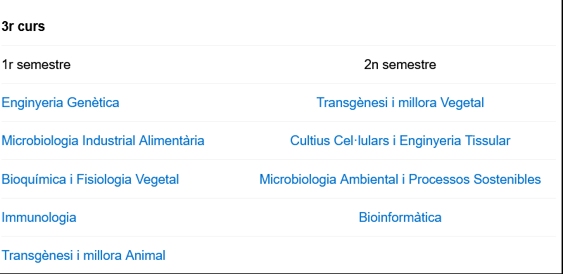
How to find the details of your courses (schedule, room…) ??
https://www.ub.edu/portal/web/biologia/graus/-/ensenyament/detallEnsenyament/6006953/24
Notes:
WEBSITE: http://www.ub.edu/ori-bio/exchange-students/courses

Slide 33
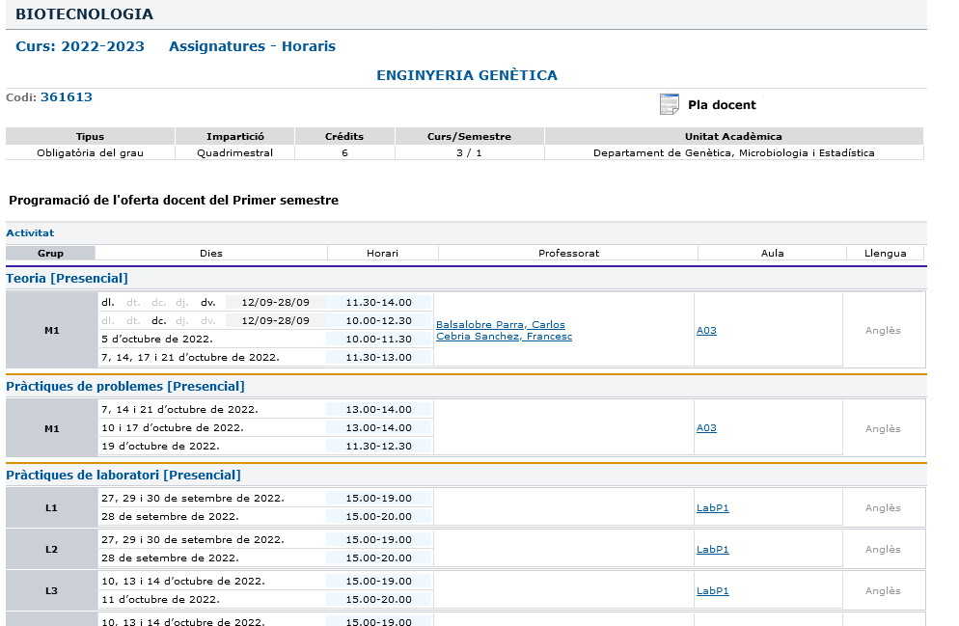
How to interpret the schedule information?
Year/semester
THURSDAY
Schedule
Classroom
FRIDAY
WEDNESDAY
Language
TUESDAY
MONDAY
Notes:
WEBSITE: http://www.ub.edu/ori-bio/exchange-students/courses

Slide 34
Evaluation system
Two systems for GRAU:
AVALUACIÓ CONTINUADA: Default pathway. Based on several items along the semester (papers, tests, oral expositions, etc) including the final exam (“prova de síntesi”).
AVALUACIÓ ÚNICA: Alternative pathway. Final exam at the end of semester only. Need to be requested by the student to the Professor by filling the form prior to the deadline.

Slide 35
Final Exams
Semester | 1st call | 2nd call
1 | January/February | June/July
2 | June/July | July or September
Timetables for the exams are posted in the web:
You are granted same rights and duties as regular UB students: no changes of dates or of type of exam

Slide 36
Exams: how to apply to the 2nd call
Normally, you are no longer in BCN on the dates of the 2nd call for examination.
The following arrangement may be done (if professor agrees):
1) We send the exam + instructions to the Erasmus coordinator of your home university.
2) He/she warrants that you take the exam the same date and time as the regular students of UB.
3) He/she returns the filled exam by fax to us.
4) We hand it to the professor, who will correct it and grade it.
IF YOU FAIL THE 1ST CALL AND WANT TO APPLY TO THE 2ND OR YOU WANT TO GIVE IT UP, PLEASE CONTACT US PRIOR TO YOUR DEPARTURE.

Slide 37
UB Digital Card
Once you are registered, you will be able to request your UB Digital Card.
Please see the link below:
http://www.ub.edu/carnet/en/alumnat.html

Slide 38
Moodle Platform
Once you are registered, we’ll send you the registration form. The registration form provides each student with a NIUB and a Code 4 characters (Identificador) that enables you access the UB INTRANET

Slide 39
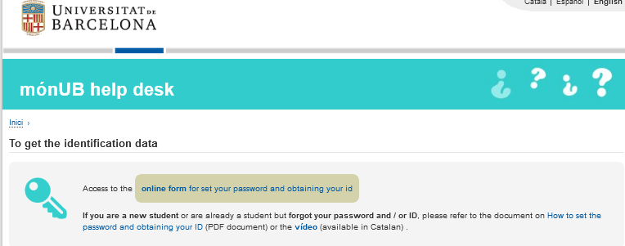
First, you have to create a password
Instructions :
http://www.ub.edu/monub/ajuda/index_en.html
http://www.ub.edu/monub/ajuda/how-obtain-password.pdf
https://auten.ub.edu/auten/NovaPasswordAlum?lang=en
fill ID ; NIUB (you'll see it in the registration form), date of birth and email and send. You'll receive instructions and a link to create a new password at the personal email address on record in your file
Password : 8 characters minimum (maximium 16); It has to contain capital and lowercase letters, symbols and numbers

Slide 40
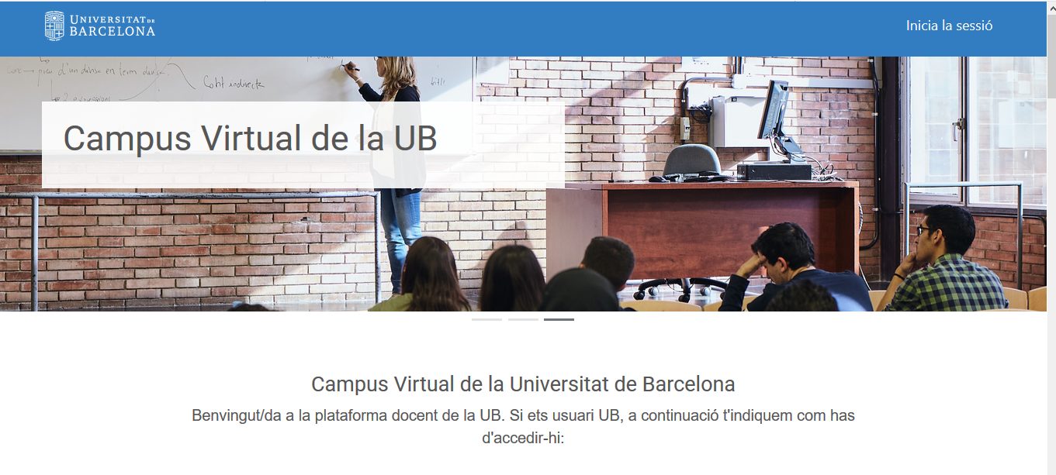
Campus virtual (Moodle Platform)
When you have your password you can access campus virtual UB
https://campusvirtual.ub.edu/
then inicia sessió
your “Identificador” is a code of 4 characters that appears in your registration form and Password : the one you have created

Slide 41
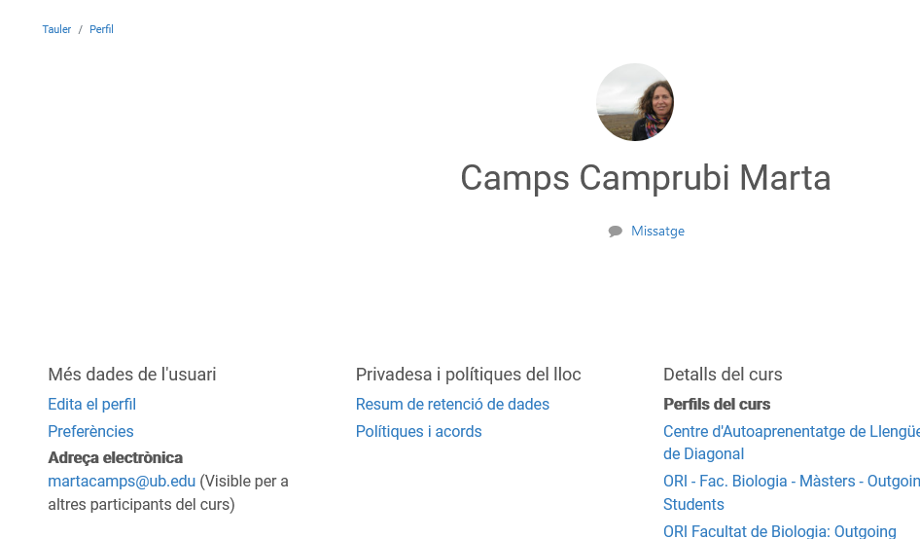
How can I get my UB e-mail
In campus virtual, “Perfil” Section you’ll find “adreça electronica”

Slide 42
Access the Mail on Cloud
You can access to the UB Mail on Cloud directly from the nuvol.alumnes.ub.edu address, or from the Intranet (The Intranet or personal space for students is called La Teva UB) of MónUB.
In all of these cases, the identification data are the following ones:
-your UB e-mail address
(for example: jherg007@alumnes.ub.edu)
-the password (the same one you use to access to the MónUB Intranet or to the Campus Virtual)

Slide 43
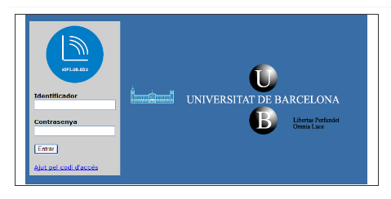
Access to Wifi
You can access to Wifi
Identificador: first part of your UB e-mail address +.alumnes
(for example: jherg007@alumnes.ub.edu
jherg007.alumnes)
Password (the same one you use to access to the MónUB Intranet or to the Campus Virtual
* -

Slide 44
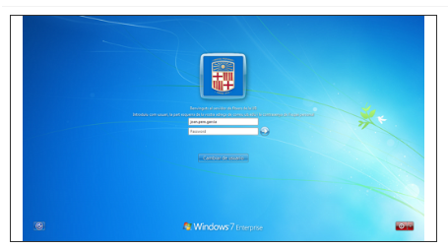
Open sessions computers (library or computer rooms)
You can access to the UB computers
Identificador: first part of your UB e-mail address +.alumnes
(for example: jherg007@alumnes.ub.edu
jherg007.alumnes)
Password (the same one you use to access to the MónUB Intranet or to the Campus Virtual
* -

Slide 45
Calendar (Holidays)
Teaching during the 1st semester (Graus): 12th September- 22nd December 2022 and 9th to 13th January 2023
Exams 1st semester : 17th January to 6th February 2022
26th September 2022 “La Mercè” Barcelona’s Festival
12th October 2022 1 “Hispanity day”
1st November 2022 (Tuesday) (bridge 31st October Monday)
6th December 2022 (Tuesday) “Immaculate”
8th December 2022 (Thursday) “Constitution day” (bridge 9th December 2022 Friday)
23rd December 2022 - 8th January 2023 Christmas vacation

Slide 46
Calendar (Holidays)
Teaching during the 2nd semester (Graus): 13th February- 31st March and 11th April-26th May 2023
Exams 2nd semester : 30th May - 16th June 2023
1st April – 10th April 2022 Easter vacation
23rd April 2023: Sant Jordi – Institutional Holliday at UB (only practicals, no lectures)
1st May 2023
5th June 2023 Segona Pasqua

Slide 47
Cancellation
If you decide to cancel your Erasmus programme prior to the end of the course,
You must inform us of your cancellation by writing.

Slide 48
Farewell
At the end of the course, please visit our office to say goodbye.
We need to register your departure date and fill your certificate of attendance.
We will send the Transcript of Records by e-mail and post mail to your home university and to you.

Slide 49
Thanks !!!!

